Slide 1
Decompose for Packing Summary & Extensions
Tomer Gareh
Or Perel
Amit Marcus

Slide 2
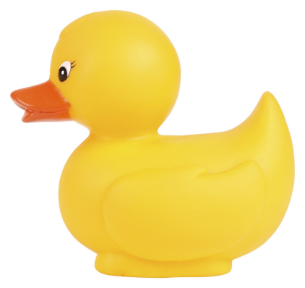

Introduction
With the first version of Decompose for Packing implemented, we identified problems with complex objects and started looking for new ways to improve the algorithm.
Features that further improve the algorithm’s results.
Optimizations that save time and allow more complex objects to be processed.
Small simple objects like the left one show satisfying results.
Bigger complex objects however, suffer from a large processing overhead.

Slide 3
Features List
The following is a list of features we have compiled and their current status.

Slide 4
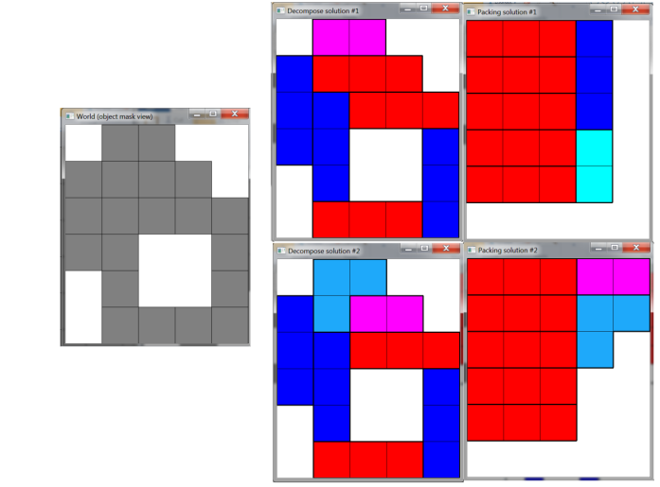
Features List
Grading
Decomposition & Packing results are graded and sorted according to pre-determined criteria such as number of parts and box shape.
This allows favored results to show first.

Slide 5
Features List
Decomposition to custom sizes
After running the algorithm for large objects, we weren’t satisfied with the amount of small parts in the final result and the long processing time.
In this feature – parts define templates that come in various sizes. The algorithm will strive to first decompose to as many larger parts as possible, gradually using smaller parts to fill the remaining holes, thus reducing the final number of parts.

Slide 6
Features List
Identification of adjacent parts
A new improved version of the grading feature.
Results with parts that were adjacent in the original object are favored (can be “glued”).
+1 to solution

Slide 7
Features List
Optimized construction of Algorithm X’s matrix
Benchmarks show that for larger objects, the process that builds Algorithm X is a major bottleneck. This optimization uses prime numbers to dramatically speed up the process that builds Algorithm X’s matrix.
 | 3 7
2
5
11 | 13
2
5
11
2 | 3
5 | 7
11 | 13 | 17
19 | 23 | 29 | 31
2 | 3
5 | 7

Slide 8
Features List
Feature name | Type | Current status
Grading | Algorithm improvement | Implemented
Decompose to custom part sizes | Algorithm improvement + Optimization | Implemented
Identification of adjacent parts | Algorithm improvement | Debated
Optimized construction of Algorithm X’s matrix | Optimization | Postponed due to focus on smaller objects

Slide 9
Grading

Slide 10
Grading
The decomposition process returns varied solutions.
For each such solution we run the packing process.
Each packing process also returns varied solutions for that single decomposition solution.

Slide 11
Grading
Initial filtering:
For each decomposition solution we take one packing solution with the minimal bounding box (in 2D – area; in 3D – volume).
Other packing solutions with the same bounding box that are arranged slightly different inside the box are considered identical (since they don’t change the final box shape).

Slide 12
Grading
Second criteria:
From all the selected packing solutions that pass the initial filtering, we find the one with minimal bounding box again.
In addition, we compute the number of parts of each selected solution and find among them the one with the minimum number of parts.

Slide 13
Grading
Second criteria (continued):
We then grade the solutions relatively to the minimal values (bounding box and number of parts).
The bounding box value constitutes 60% of the grade and the number of parts constitutes 40%. Meaning that the solution with the minimal bounding box size will get 60 points for it, and the solution with the minimal number of parts will get 40 points.
The percentages are easily configurable.

Slide 14

Grading (Second criteria)
Finally we display the selected solutions (decompose and packing) sorted according to this criteria.

Slide 15
Decomposition to custom sizes

Slide 16
Decomposition to custom sizes (Problem Overview)
Large objects may contain thousands of pixels.
Decompose and Packing will take too much time:
Small parts assembles countless solutions for the same object.
The algorithm is naïve – it checks all possible positions of each of the parts in the large object.

Slide 17
Decomposition to custom sizes (Solution)
What can we do about it:
Shrink the object – choose how many pixels will represent one point in the object.
Use large parts for large objects. We will cover the object with large parts as much as we can, and gradually switch to smaller part sizes to fill the remaining holes until the object is completely covered.

Slide 18
Decomposition to custom sizes (Solution)
The new algorithm:
Shrink the object by changing pixel / voxel resolution.
Try to decompose the object with large parts first.
This part of the algorithm runs a modified version of Algorithm X that allows a partial cover of solutions.
Algorithm X will strive to return a complete cover of a universe, but if it fails to do so, it will return the best partial cover it could find.
Reduce the part size and repeat the last step with the remaining holes in the object, until we decompose the whole object (each time using smaller parts).

Slide 19
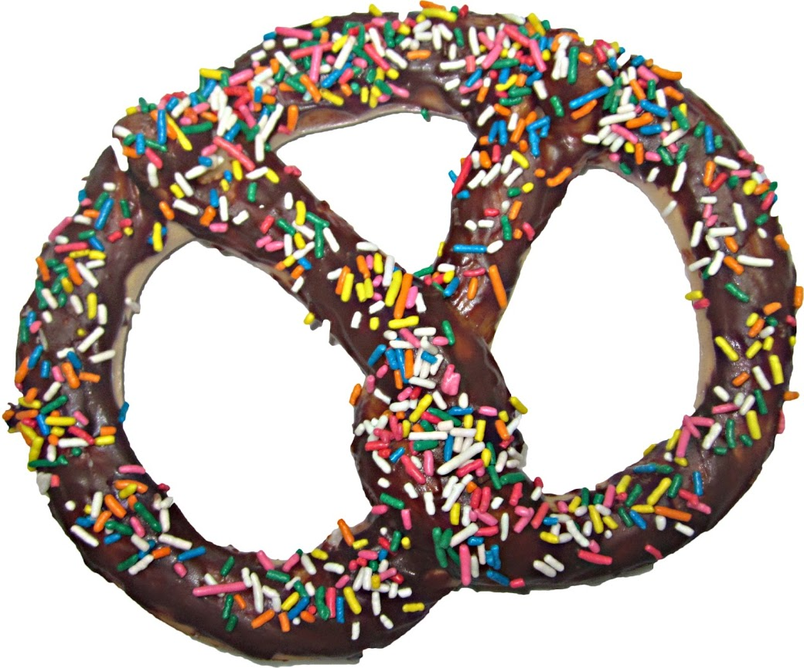
The bagel example

Slide 20
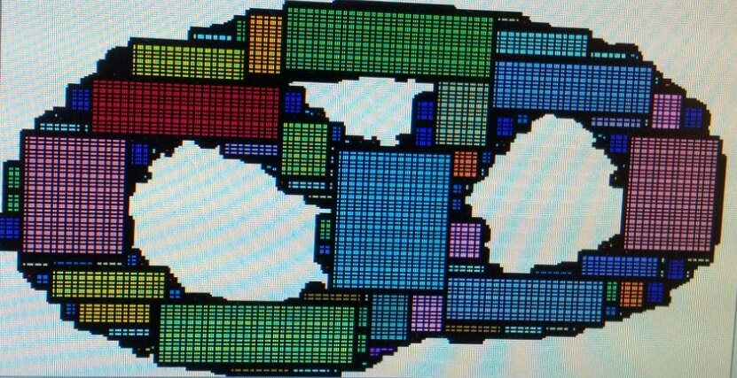
The bagel example

Slide 21
Building Algorithm X’s Matrix

Slide 22
Building Algorithm X’s Matrix (Reminder)
Reminder: The input of Algorithm X is a pre-built matrix.
Columns represent each of the values in the universe.
Rows represent each of the sets that cover together the entire universe.
Sets\Universe | 1 | 2 | 3 | 4 | 5
{1, 3} | 1 | 0 | 1 | 0 | 0
{1, 2, 4} | 1 | 1 | 0 | 1 | 0
{2, 4, 5} | 0 | 1 | 0 | 1 | 1
{1, 5} | 1 | 0 | 0 | 0 | 1

Slide 23
Building Algorithm X’s Matrix (Reminder)
Reminder: For Decomposition –
Each column represents a position in the world (pixel, voxel).
Each row represents an orientation of a part, positioned in a particular location in the world.
1
0 | 1 | 2
3 | 4 | 5
6 | 7 | 8
0
2
{ 0, 3, 4, 6 }
3
5
0 | 1 | 2
3 | 4 | 5
6 | 7 | 8
6
8
{ 1, 4, 5, 7 }
4
7

Slide 24
Building Algorithm X’s Matrix (Reminder)
Reminder: For Packing –
Each column represents a position in the world (pixel, voxel) or a decomposed part ID.
Each row represents an orientation of a certain decomposed part, positioned in a particular location in the world.
11
0 | 1 | 2
3 | 4 | 5
6 | 7 | 8
+
{ 0, 3, 4, 6, 11}
Positions / Part Ids
100110100 001

Slide 25
Building Algorithm X’s Matrix (Reminder)
A naïve solution iterates all possible locations for each part.
100110100 001
000110000 100
010110000 010
010011010 001
000011000 100
001011000 010
110000000 100
000000110 100
000010110 010
011000000 100
000000011 100
000001011 010

Slide 26
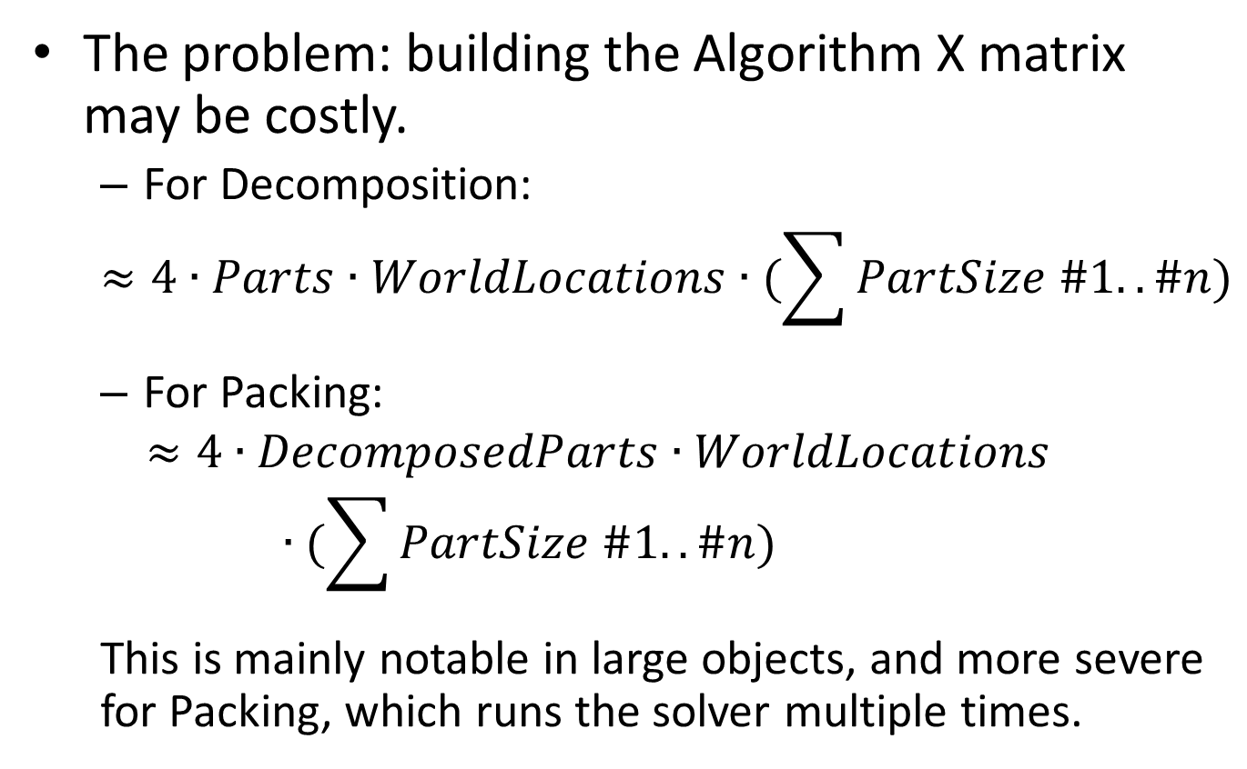
Building Algorithm X’s Matrix (Problem overview)
The problem: building the Algorithm X matrix may be costly.
For Decomposition:
$$≈4∙Parts∙WorldLocations∙(\sum{PartSize \#1.. \#n})$$
For Packing:
$$≈4∙DecomposedParts∙WorldLocations∙(\sum{PartSize \#1.. \#n})$$
This is mainly notable in large objects, and more severe for Packing, which runs the solver multiple times.

Slide 27
Building Algorithm X’s Matrix (Problem Analysis)
Can we do better?
Observation: We repeatedly recalculate identical information for different orientations for each location in the world.
i.e: observe the middle square in the world. Each part calculates whether that location may be occupied by a part.

Slide 28
Building Algorithm X’s Matrix (Solution Overview)
Solution: Utilize Dynamic Programming.
(I) - There is no need to iterate with each part separately. We create a “parts overlay mask” (a window) and iterate all part locations together.
(II) - Each time we advance to a new location, we only need to scan the new column (or row) encountered. The rest of the values can be calculated by a pre-defined function.
Intuition: Observe the “holes” in the world advance uniformly as the window iterates over the world.

Slide 29
Building Algorithm X’s Matrix (Solution – Part I)
The part mask is the parts orientations layered on each other.
Assign each location on the part mask a primary number.
2 | 3
5 | 7
11 | 13 | 17
19 | 23 | 29 | 31

Slide 30
Building Algorithm X’s Matrix (Solution – Part I)
In a similar manner, we assign a primary number for each location in each part orientation.
Each part orientation gets a value: the multiplication of the primary numbers occupying its locations.
Part values are guaranteed to be unique per orientation.
2*3*11*13=858
2*3*5*7=210
2 | 3
5 | 7
11 | 13 | 17
19 | 23 | 29 | 31
2
5
11 | 13
2
5
11
2
5 | 7
11
 | 3
5 | 7
 | 13
2 | 3
5 | 7
 | 3
5 | 7

Slide 31

Building Algorithm X’s Matrix (Solution – Part I)
Use the window to iterate over the world.
Denote the top-left location of the window as “the anchor”.
Iterate “the anchor” over each location of the world.
For each location of the world we scan, store in it the multiplication of the values of the window that match vacant locations in the world.
=$2∙5∙11∙19∙13∙23∙17∙29∙31$
2 | 3
5 | 7
11 | 13 | 17
19 | 23 | 29 | 31

Slide 32

Building Algorithm X’s Matrix (Solution – Part I)
Second iteration:
=$3∙7∙11∙19∙13∙23∙17∙29∙31$
2 | 3
5 | 7
11 | 13 | 17
19 | 23 | 29 | 31
Note: We treat locations exceeding the borders
of the world as “holes”.

Slide 33
Building Algorithm X’s Matrix (Solution – Part I)
For each location in the world, for each part –
Divide Location value by part orientation value.
If the result is a whole number, that part orientation can be placed in that location, add a row to the Algorithm X matrix.
Else do nothing.
=$2∙5∙11∙19∙13∙23∙17∙29∙31$
Can be placed:
2*3*11*13=858
Cannot be placed: 2*3*5*7=210
2
5
11 | 13
2 | 3
5 | 7

Slide 34
Building Algorithm X’s Matrix (Solution – Part I)
Why does it work?
Part values are built by building blocks: their locations, whereas each location in the part is a unique primary number.
Location values in the world enclose the available locations relative to the anchor also using primary numbers.
Division by primary numbers allows fast discovery of part-world locations matching.
=$2∙5∙11∙19∙13∙23∙17∙29∙31$
Cannot be placed: 2*3*5*7=210
Can be placed:
2*3*11*13=858
2 | 3
5 | 7
11 | 13 | 17
19 | 23 | 29 | 31
2 | 3
5 | 7
2
5
11 | 13
3 & 7 are missing

Slide 35

Building Algorithm X’s Matrix (Solution – Part I)
So far we reduced to –
$WorldLocations∙(WindowSize$+ NumOf$Parts$)
From:
$$4∙Parts∙WorldLocations∙(\sum{PartSize \#1.. \#n})$$
2 | 3
5 | 7
11 | 13 | 17
19 | 23 | 29 | 31

Slide 36
Building Algorithm X’s Matrix (Solution – Part II)
Can we do better?
Observation: Every time we advance the “window”, the holes in the world move 1 square to the left or upwards relative to the window.
 | 3 7
 | 2 5
Holes 3 & 7 move to the left with the next iteration, now covering 2 & 5

Slide 37
Building Algorithm X’s Matrix (Solution – Part II)
This situation will repeat itself every time a hole is encountered.
In fact, we can easily prove that every time a hole covers location 3 in the window and the window moves right, during the next iteration it will cover location 2.
Similarly know that when the window goes to the next row, holes covered by location 5 now cover location 2 in the window.

Slide 38
Building Algorithm X’s Matrix (Solution – Part II)
So what do we know so far?
We only care about the holes in the world, other locations can be ignored.
The only changes between each iteration of the window (every time we move the anchor point over the world) are:
The locations of the currently discovered holes within the world move in a known direction, so we can automatically compute the change they cause to the location value.
We only have to scan the newly discovered locations in the world for new holes. E.g:
When we move the window right, we get a new column.
When we move downward, we get a new row.

Slide 39
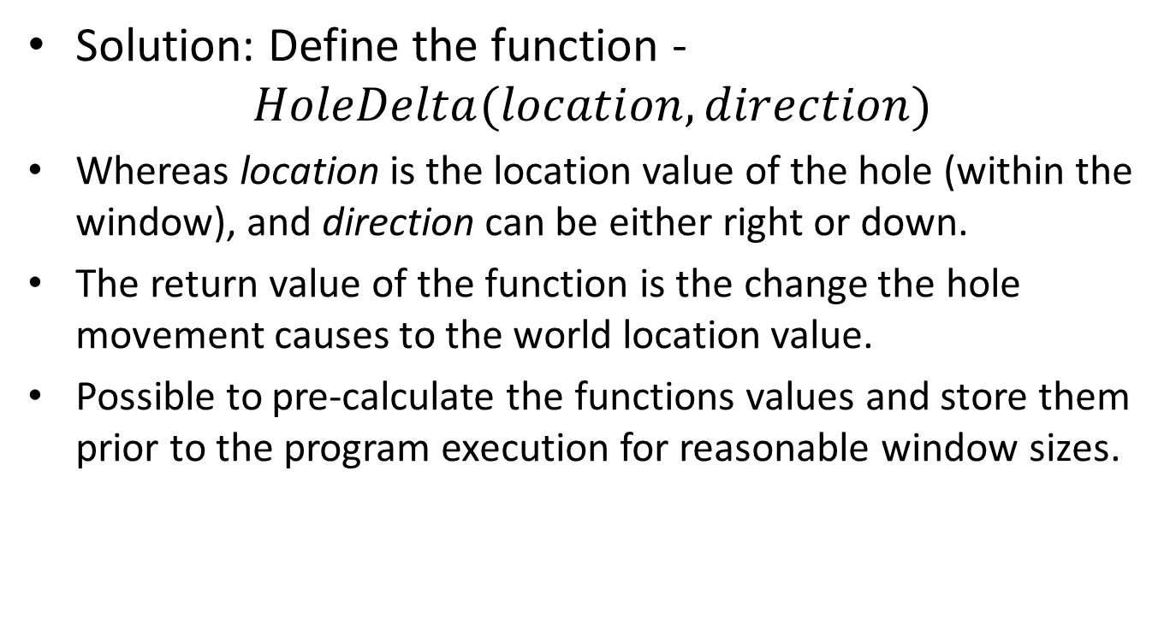
Building Algorithm X’s Matrix (Solution – Part II)
Solution: Define the function -
$$HoleDelta(location, direction)$$
Whereas location is the location value of the hole (within the window), and direction can be either right or down.
The return value of the function is the change the hole movement causes to the world location value.
Possible to pre-calculate the functions values and store them prior to the program execution for reasonable window sizes.

Slide 40
Building Algorithm X’s Matrix (Solution – Part II)
Example:
 | 3 7
 | 2 5
$$HoleDelta\left(3, right\right)=2/3$$
$$HoleDelta\left(7, down\right)=3/7$$

Slide 41

Building Algorithm X’s Matrix (Solution – Part II)
So the algorithm is reduced to -
$$ComputeNextWorldLocationValue(AnchorX, Anchor Y, HolesList,$$
$Direction, WorldLocationValue$)
If Direction = Right then
For each hole in the leftmost column in the window do
WorldLocationValue *= HoleLocationValue
HolesList.remove(Hole)
For each other discovered hole in the window do
WorldLocationValue *= HoleDelta(HoleLocation, Direction)
For each location discovered on the new rightmost column
If location == hole then
HolesList.add(location)
WorldLocationValue /= LocationValue
If Direction = Down then // Symmetrical to Right …..
Return WorldLocationValue

Slide 42
Building Algorithm X’s Matrix (Solution – Part II)
To initialize the algorithm, we scan for holes at the window size and compute the first world location value manually.
We iterate at each direction until all window locations are holes (this signals we’ve crossed the border of the world).
Can query the number of holes found against the number of locations within the window for fast boundary test.
We scan each location once. We scan each hole times the dimensions of the window

Slide 43
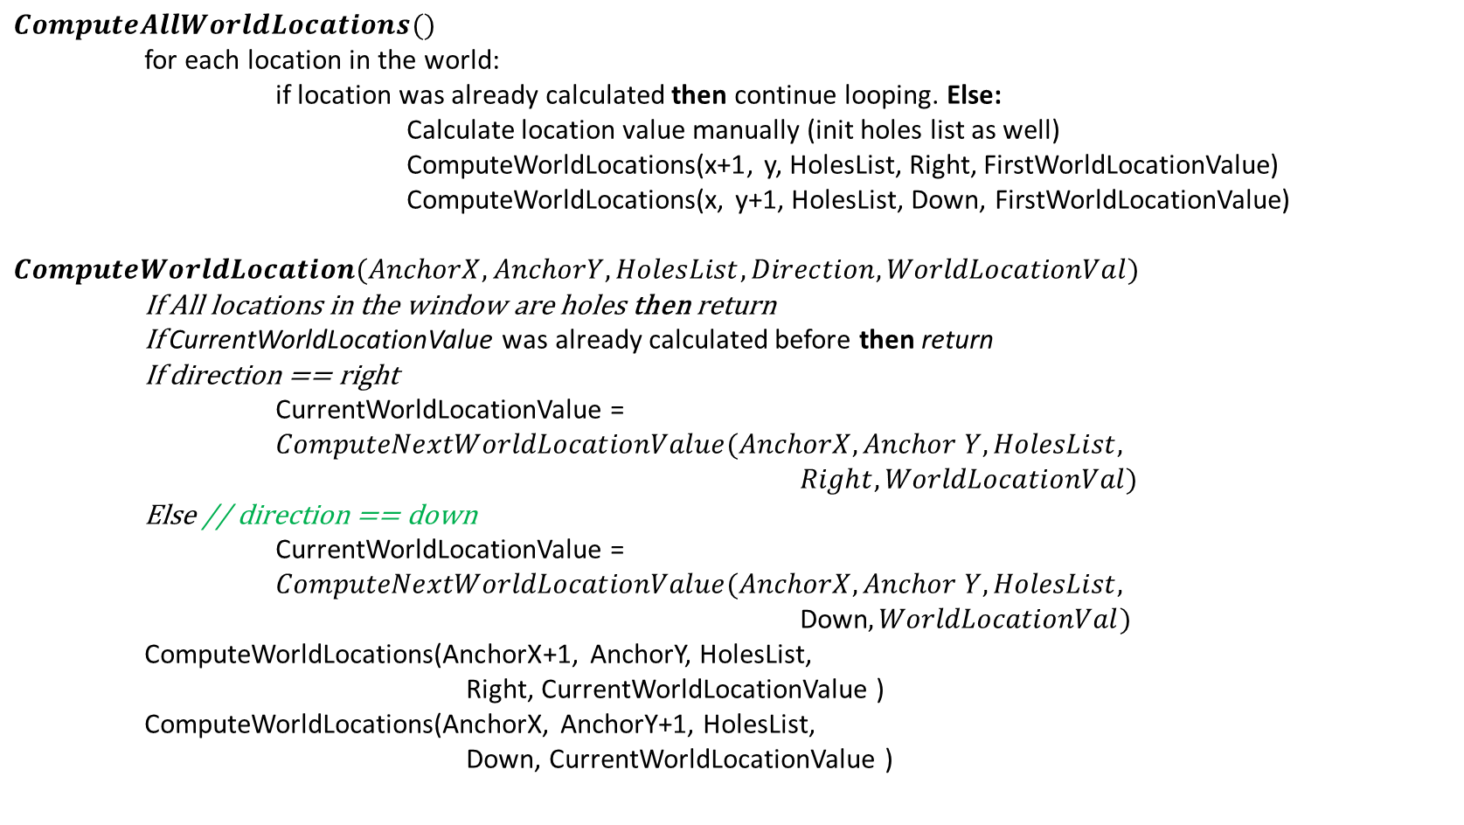
Building Algorithm X’s Matrix (Solution – Part II)
$$ComputeAllWorldLocations()$$
for each location in the world:
if location was already calculated then continue looping. Else:
Calculate location value manually (init holes list as well)
ComputeWorldLocations(x+1, y, HolesList, Right, FirstWorldLocationValue)
ComputeWorldLocations(x, y+1, HolesList, Down, FirstWorldLocationValue)
$$ComputeWorldLocation(AnchorX, AnchorY, HolesList, Direction, WorldLocationVal)$$
If All locations in the window are holes then return
If CurrentWorldLocationValue was already calculated before then return
If direction == right
CurrentWorldLocationValue = $ComputeNextWorldLocationValue(AnchorX, Anchor Y,HolesList,$
$Right, WorldLocationVal)$
Else // direction == down
CurrentWorldLocationValue = $ComputeNextWorldLocationValue(AnchorX, Anchor Y,HolesList,$
Down$, WorldLocationVal)$
ComputeWorldLocations(AnchorX+1, AnchorY, HolesList,
Right, CurrentWorldLocationValue )
ComputeWorldLocations(AnchorX, AnchorY+1, HolesList,
Down, CurrentWorldLocationValue )

Slide 44
Building Algorithm X’s Matrix (Solution – Part II)
The algorithm’s use of dynamic programming can be deferred from the following diagram:
Note that if we encounter the same location again, we simply stop going in that direction.
The benefit of this advancement method is the ability to recurse objects with complex
shapes (like big holes in the middle of the object).

Slide 45
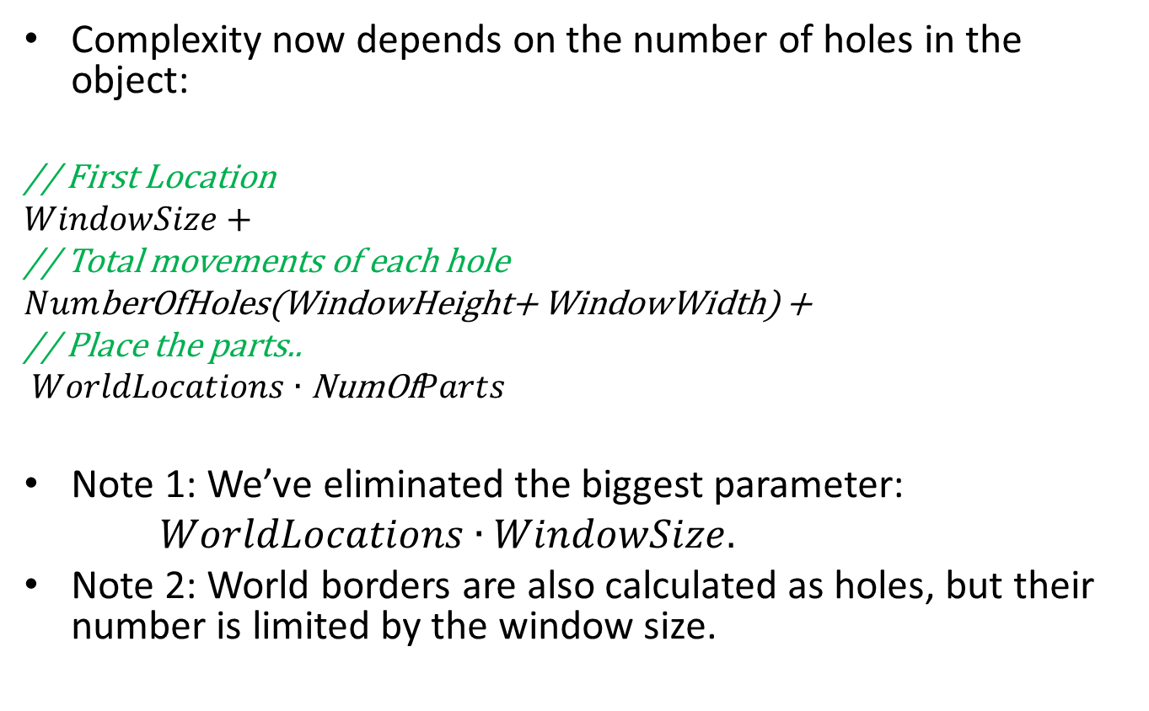
Building Algorithm X’s Matrix (Solution – Part II)
Complexity now depends on the number of holes in the object:
// First Location
$WindowSize+$
// Total movements of each hole
$Num$berOfHoles(WindowHeight+ WindowWidth) +
// Place the parts..
$WorldLocations∙\text{NumOf}Parts$
Note 1: We’ve eliminated the biggest parameter:
$WorldLocations∙WindowSize.$
Note 2: World borders are also calculated as holes, but their number is limited by the window size.

Slide 46

Building Algorithm X’s Matrix (Use cases)
This optimization is particularly useful for large objects with big contiguous areas.
For very smaller objects, the naïve method of building the matrix still holds.

Slide 47
Building Algorithm X’s Matrix (Practical tips)
Practical implementation observations:
Primary numbers are expensive to discover at run-time.
Use a pre-generated data file containing enough primary numbers & load at program startup.
Dividing & multiplying primary numbers yields fractions and may cause floating point mistakes. Use modulo or rounding to overcome precision problems and gain back your integers.
As a general rule of thumb, wherever possible, we prefer to utilize primary numbers multiplication to store information. Even when asymptotically results should be the same – we expect ALU operations (multiply / divisions of primary numbers) to perform better than multiple memory reads & writes.
ALU operations may also leverage SIMD operations to accelerate the process even further.

Slide 48
Identification of Adjacent Parts

Slide 49
Identification of Adjacent Parts (Problem overview)
Decomposition is made to pre-determined part templates.
The idea: after decomposition try to “glue” adjacent parts (in the original object) that appear adjacent in the packing solution in order to get them back together.
From practical point of view, this can optimize the assembling process after printing the parts in a 3D-printer.

Slide 50
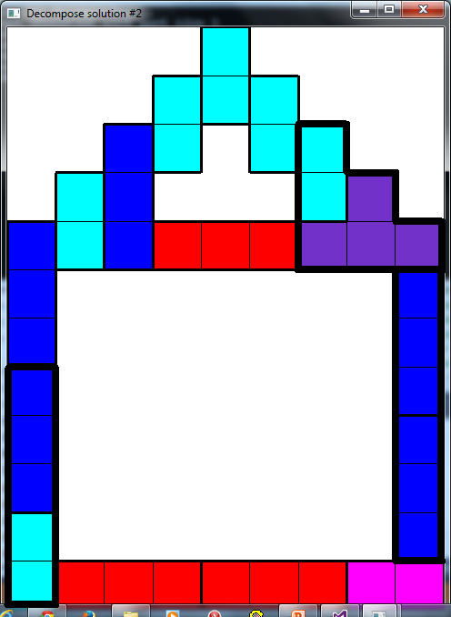
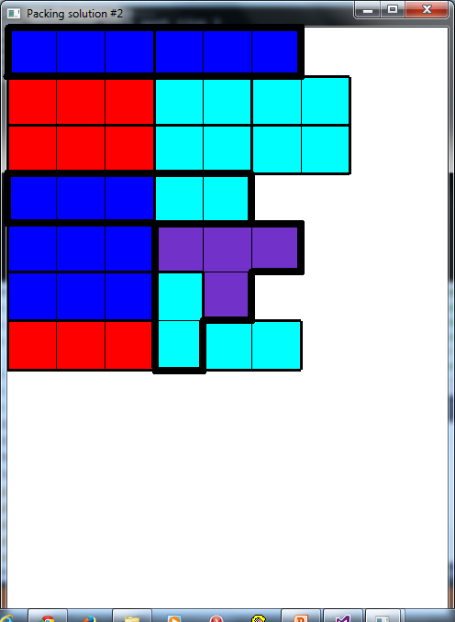
Identification of Adjacent Parts (Example)

Slide 51
Identification of Adjacent Parts (Solution)
Adjacency parts: during decomposition we will keep for each part its neighbors.
As in the “Window Optimization” (previous chapter), we will use primary numbers to identify the different parts.
For each part instance, we will compute the multiplication of its neighbors so that each “adjacency cube” will have unique value.
 | 11 | 13
.. | 3 | 17 | 23
.. | 2 | 5 | 33 | 31
.. | 7 |  |  | 29
 | ..
 | .. | .. | .. | ..
Neighbor’s multiplication of yellow #2 is: 3 * 5 * 7

Slide 52
Identification of Adjacent Parts (Solution)
During packing: we will check which of the current neighbors were also neighbors in the decomposition solution.
For each part, for each neighbor of the part, we will check if the neighbor's number divides the original multiplication of the current part. I.e. this neighbor was also a neighbor in the original object.
7
59 |  | 13
.. | ..
11
 | 17
.. | 3
.. | 2
..
 | 31
23 | 33
 | 5
- Neighbor’s multiplication of 2 is: 3 * 5 * 7
- Pixel 3 divides this multiplication and is therefore a neighbor
61 | 67

Slide 53
Identification of Adjacent Parts (Solution)
Packing solutions with more adjacent parts will get a higher grade at the grading stage.
+1 to solution

Slide 54
Identification of Adjacent Parts (Debate)
Our algorithm chooses a “Top to Bottom” approach (gradually decompose the whole object to parts). Therefore we have no way of gluing adjacent parts until packing stage is over.
When packing stage is over, we have to iterate all parts in all solutions and review their neighbors. This could prove to be time-consuming for complex objects.

